Slide 1
Substance Use Prevention Jeopardy
Being Outstanding Leaders Together Against Drugs and Alcohol
Virginia Alcoholic Beverage Control Authority
Education and Prevention

Slide 2
Jeopardy Instructions
To start: the first team will pick the first category to answer a question from.
Once the Jeopardy Host finishes reading the question, any team can buzz in to answer. The first team to buzz in, gets to answer.
If the team answers right, they win the points assigned to the question.
If the team answers wrong, the team who buzzed in second can answer (in true Jeopardy the first team also loses those points).

Slide 3
Jeopardy Instructions
Daily Doubles: There is one Daily Double in each round. If a Daily Double is picked, the team can wager any amount of points up to their current score. If they answer correctly, they win those points. If they answer incorrectly, the lose those points.
Final Jeopardy: At the end of the second round (or first round if you’re only playing one round), teams with positive scores play Final Jeopardy. Players are given the title of the category and they must wager any point value up to their current score. After wagers have been made, the Jeopardy Host reads the question and allows teams 30 seconds to write down their answer. At the end of the 30 seconds, teams will read their answer and points will be awarded or deducted based on if the answer was correct.

Slide 4
Substance Use Prevention Jeopardy Round 1
Alcohol 101 | Virginia Facts | Refusal Skills | Alcohol Use Long-term Consequences | Alcohol Use Short-term Consequences
$200 | $200 | $200 | $200 | $200
$400 | $400 | $400 | $400 | $400
$600 | $600 | $600 | $600 | $600
$800 | $800 | $800 | $800 | $800
$1,000 | $1,000 | $1,000 | $1,000 | $1,000

Slide 5
Substance Use Prevention Jeopardy Round 2
Drugs 101 | In the Media | Addiction | Substance Use Influences | Consequences of Drug Use
$400 | $400 | $400 | $400 | $400
$800 | $800 | $800 | $800 | $800
$1,200 | $1,200 | $1,200 | $1,200 | $1,200
$1,600 | $1,600 | $1,600 | $1,600 | $1,600
$2,000 | $2,000 | $2,000 | $2,000 | $2,000
FINAL JEOPARDY (TOPIC: ALCOHOL 101)

Slide 6
Which of these is not an alcoholic beverage?
Final Jeopardy
Answer

Slide 7
The “True” energy drink Alcohol can come in many variations and can look like normal drinks that you or your parents might drink at home or a restaurant.
Final Jeopardy Answer

Slide 8
This is created naturally when sugars in grains, vegetables and fruits are fermented.
$200 Question from Alcohol
Answer

Slide 9
What is alcohol? Alcohol can come in many forms including: beer, wine and liquor.
$200 Answer from Alcohol

Slide 10
True or False: The way your body reacts to alcohol can depend on your biological sex.
$400 Question from Alcohol
Answer

Slide 11
What is true? Male and female bodies process alcohol differently. Weight is also a factor in processing alcohol.
$400 Answer from Alcohol

Slide 12
The organ that metabolizes, or breaks down, alcohol.
$600 Question from Alcohol
THE DAILY DOUBLE
Answer

Slide 13
What is the liver? From there, alcohol is then processed by the kidneys and eliminated from your body.
$600 Answer from Alcohol

Slide 14
This is defined for males as drinking 5+ drinks in a two hour period and for females drinking 4+ drinks in a two hour period.
$800 Question from Alcohol
Answer

Slide 15
What is binge drinking? Binge drinking can lead to alcohol poisoning.
$800 Answer from Alcohol

Slide 16
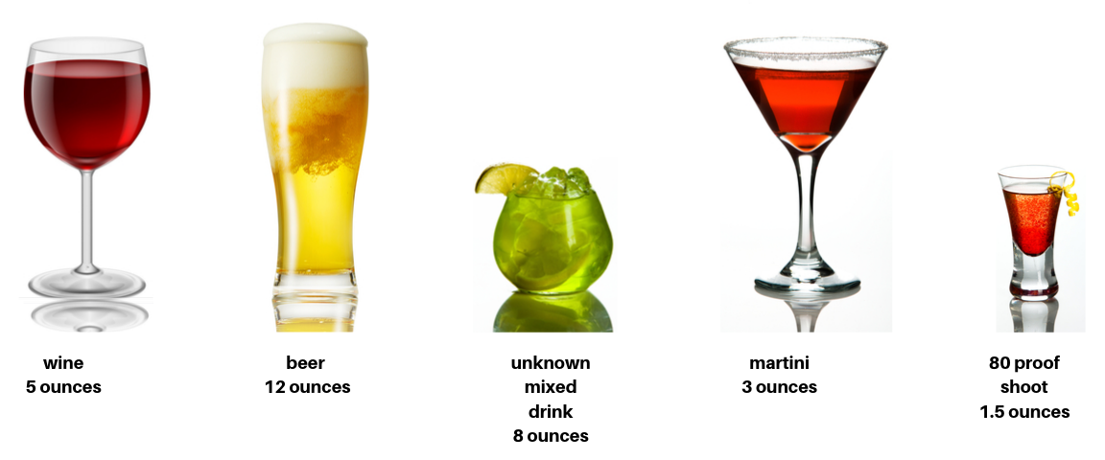
Of the following, which drinks are equal to a standard drink size?
$1,000 Question from Alcohol
Answer

Slide 17
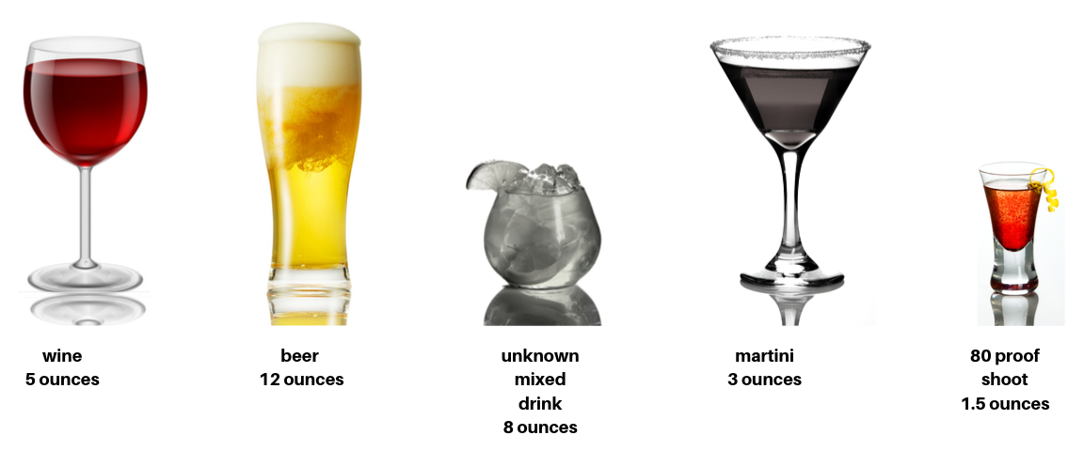
$1,000 Answer from Alcohol
What is 5 ounces of wine, 12 ounces of beer and a 1.5 ounce shot of 80 proof liquor? The mixed drink and the martini we do not know how much alcohol is in it.

Slide 18
This is the legal age to purchase alcohol and tobacco products in Virginia.
$200 Question from Virginia Facts
Answer

Slide 19
What is 21 years old?
$200 Answer from Virginia Facts

Slide 20
This organization regulates and monitors the supply and sale of alcohol in Virginia.
$400 Question from Virginia Facts
Answer

Slide 21
What is Virginia Alcoholic Beverage Control Authority? Virginia is a control state, meaning that the state’s government is responsible for regulating and monitoring alcohol sales.
$400 Answer from Virginia Facts

Slide 22
True or False: Parents cannot be held legally responsible for providing alcohol to someone under the age of 21.
$600 Question from Virginia Facts
Answer

Slide 23
What is false? Parents can be held legally responsible for providing alcohol to someone under the age of 21 years old. Legal consequences can include: up to one year in jail and/or a $2,500 fine.
$600 Answer from Virginia Facts

Slide 24
This percentage of Virginia high schoolers reported having their first drink of alcohol before age 13.
$800 Question from Virginia Facts
Answer

Slide 25
What is about 15%? This means that over 85% of Virginia middle school students aren’t drinking alcohol.
$800 Answer from Virginia Facts

Slide 26
This percentage of Virginia middle schoolers reported talking with their parents or other adult family members about alcohol, tobacco or other drugs.
$1,000 Question from Virginia Facts
Answer

Slide 27
What is 30%? It is important to talk with your family about substance use and the harms and consequences associated with illegal and youth substance use.
$1,000 Answer from Virginia Facts

Slide 28
“I can’t. I have a test tomorrow.” “I don’t like the taste.” “It’s just not for me.” are all examples of…
$200 Question from Refusal Skills
Answer

Slide 29
What are ways to refuse alcohol, tobacco or other drugs? You should never do anything you don’t want to do, including drinking alcohol and using tobacco products or other drugs.
$200 Answer from Refusal Skills

Slide 30
Not hesitating with your answer, looking directly at the person, and keeping your response short, clear and simple are examples of this.
$400 Question from Refusal Skills
Answer

Slide 31
What are strategies to successfully refuse peer pressure to use alcohol, tobacco or other drugs?
$400 Answer from Refusal Skills

Slide 32
True or False: It’s important for you to notify your parents if you are offered alcohol, tobacco or other drugs from a friend, peer or adult.
$600 Question from Refusal Skills
Answer

Slide 33
What is true? Your parents may need to address the issue with your peers’ parents or the adult that offered them to you.
$600 Answer from Refusal Skills

Slide 34
This percentage of 8th graders reported that they disapprove of people who have one or two drinks of alcohol every day.
$800 Question from Refusal Skills
Answer

Slide 35
What is about 80%?
$800 Answer from Refusal Skills

Slide 36
Bowling, ice skating, going to the movies, learning new hobbies or playing sports instead of using substances are examples of…
$1,000 Question from Refusal Skills
Answer

Slide 37
What are alternate activities? Alternate activities can be anything that promotes a healthy and productive lifestyle that offers everyone an “out” from participating in unhealthy behaviors. More often than not, your peers don’t want to participate in unhealthy behaviors either.
$1,000 Answer from Refusal Skills

Slide 38
Alcohol abuse can affect brain development and growth. The brain stops fully developing during this timeframe.
$200 Question from Alcohol Use Long-term Consequences
Answer

Slide 39
What is your mid-twenties? It’s important not to drink alcohol if you’re younger than 21 years old because your brain is still developing and underage alcohol consumption can affect its development.
$200 Answer from Alcohol Use Long-term Consequences

Slide 40
True or False: If I get into legal trouble due to substance use this can affect my athletic and school life.
$400 Question from Alcohol Use Long-term Consequences
Answer

Slide 41
What is true? In addition to legal consequences, illegal substance use can lead to disciplinary actions at your school as well as on any athletic teams.
$400 Answer from Alcohol Use Long-term Consequences

Slide 42
High blood pressure, stroke, irregular heartbeat and blood clots are heart related issues that can be caused by…
$600 Question from Alcohol Use Long-term Consequences
THE DAILY DOUBLE
Answer

Slide 43
What is heavy, long-term alcohol consumption?
$600 Answer from Alcohol Use Long-term Consequences

Slide 44
Long-term alcohol use can have the following affects to this system in your body, which controls: balance and coordination, memory, sleep, nerves and behavior.
$800 Question from Alcohol Use Long-term Consequences
Answer

Slide 45
What is the Nervous System?
$800 Answer from Alcohol Use Long-term Consequences

Slide 46
This disease can be caused by heavy, long-term alcohol consumption resulting in scarring and permanent damage to the liver….
$1,000 Question from Alcohol Use Long-term Consequences
Answer

Slide 47
What is cirrhosis of the liver? Causes of cirrhosis include: alcoholic liver disease, nonalcoholic fatty liver disease, chronic hepatitis C and chronic hepatitis B.
$1,000 Answer from Alcohol Use Long-term Consequences

Slide 48
True or False: Athletic performance can be impacted by alcohol use
$200 Question from Alcohol Use Short-term Consequences
Answer

Slide 49
What is true? Alcohol consumption can cause muscle cramps, decreased endurance level and a slowed reaction time.
$200 Answer from Alcohol Use Short-term Consequences

Slide 50
BAC stands for this.
$400 Question from Alcohol Use Short-term Consequences
Answer

Slide 51
What is Blood Alcohol Concentration? BAC is the amount of alcohol that is present in the bloodstream. Too much alcohol in your bloodstream is called alcohol poisoning and can make you very sick and can even lead to death.
$400 Answer from Alcohol Use Short-term Consequences

Slide 52
Alcohol reduces this stage of sleep, the stage of sleep where dreams occur.
$600 Question from Alcohol Use Short-term Consequences
Answer

Slide 53
What is REM (rapid eye movement) sleep Disruptions in REM sleep may cause daytime drowsiness, poor concentration, and rob you of needed rest.
$600 Answer from Alcohol Use Short-term Consequences

Slide 54
Confusion, slow reflexes, inability to remain conscious and trouble breathing are signs of this.
$800 Question from Alcohol Use Short-term Consequences
Answer

Slide 55
What is alcohol poisoning? Alcohol poisoning kills six people in the United States each day. If you believe someone has alcohol poisoning, call 911 immediately.
$800 Answer from Alcohol Use Short-term Consequences

Slide 56
The inability to make good decisions and inability to process information through asking “why,” “what” and “how” questions due to alcohol consumption is called this.
$1,000 Question from Alcohol Use Short-term Consequences
Answer

Slide 57
What is a lowered reasoning ability?
$1,000 Answer from Alcohol Use Short-term Consequences

Slide 58
This type of drug is often used to treat pain.
$400 Question from Drugs 101
Answer

Slide 59
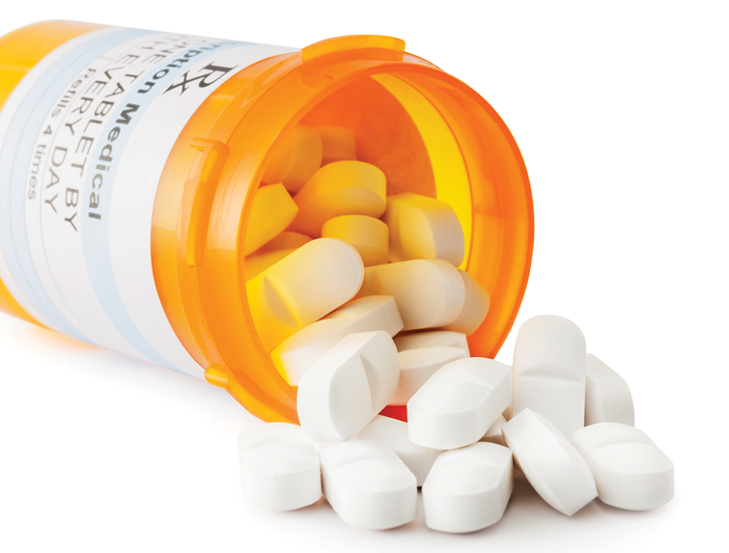
What are opioids? Opioids are most commonly given out by doctors to treat pain and are to be used only under a doctor’s prescription and observation.
$400 Answer from Drugs 101

Slide 60
This drug causes enhanced sensory perception, euphoria, drowsiness, slowed reaction time, coordination problems, increased heart rate and appetite, problems with learning and memory, hallucinations, anxiety and panic attacks.
$800 Question from Drugs 101
THE DAILY DOUBLE
Answer

Slide 61
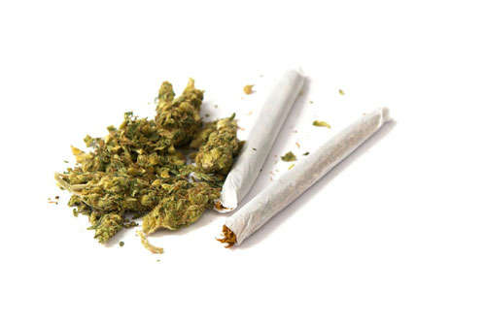
What is marijuana? Marijuana comes in many forms including, cigarettes, e-cigarettes, vapes, pipes, edibles (such as candy and baked goods), teas and oils. While marijuana use for adults is legal in some states, marijuana use is illegal federally and in Virginia.
$800 Answer from Drugs 101

Slide 62
Examples of this type of drug are cocaine, amphetamine and methamphetamine.
$1,200 Question from Drugs 101
Answer

Slide 63
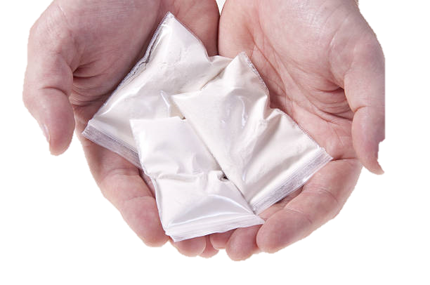
What is a stimulant? When using a drug like cocaine, the substance interferes with chemical messengers in the brain and blocks chemicals like serotonin and dopamine from being reabsorbed in the brain causing the “high” feeling.
$1,200 Answer from Drugs 101

Slide 64
This type of drug can easily be found at home in products such as cleaning supplies.
$1,600 Question from Drugs 101
Answer

Slide 65
What are inhalants? Examples of products classified as inhalants found in a home are: gasoline, spray paint, hair spray and other aerosols and volatile solvents.
$1,600 Answer from Drugs 101

Slide 66
When this neurotransmitter is released from the limbic system it associates a positive experience with drug use.
$2,000 Question from Drugs 101
Answer

Slide 67
What is dopamine? When dopamine is released in the brain it associates a positive experience with drug use and signals for the brain to remember that something important has happened and needs to happen again – causing a need or addiction to what caused the flood of dopamine.
$2,000 Answer from Drugs 101

Slide 68
The lyrics from “Young, Wild & Free” by Snoop Dog and Wiz Khalifa encourage listeners to… “So what we get drunk So what we smoke weed We're just having fun We don't care who sees So what we go out That's how it's supposed to be Living young and wild and free”
$400 Question from In the Media
Answer

Slide 69
Any of the following are acceptable answers. What is use illegal substances? What is practice unhealthy drinking behaviors? What is use being young as an excuse to break the law and practice unhealthy behaviors?
$400 Answer from In the Media

Slide 70
The average teen is exposed to drug references in popular music this many times per day.
$800 Question from In the Media
Answer

Slide 71
What is 85 times per day?
$800 Answer from In the Media

Slide 72
Social media advertisements use techniques such as celebrities, humor and pop culture references to encourage this…
$1,200 Question from In the Media
Answer

Slide 73
What is youth substance use?
$1,200 Answer from In the Media

Slide 74
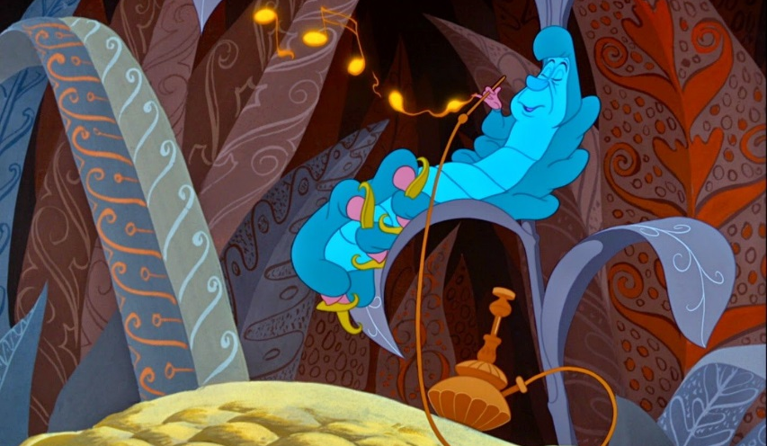
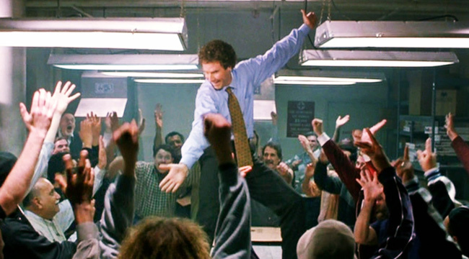
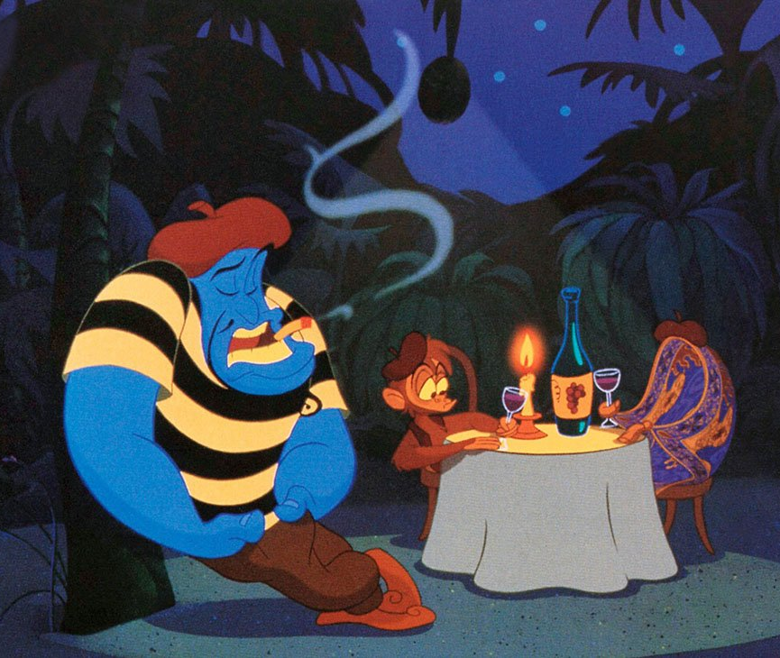
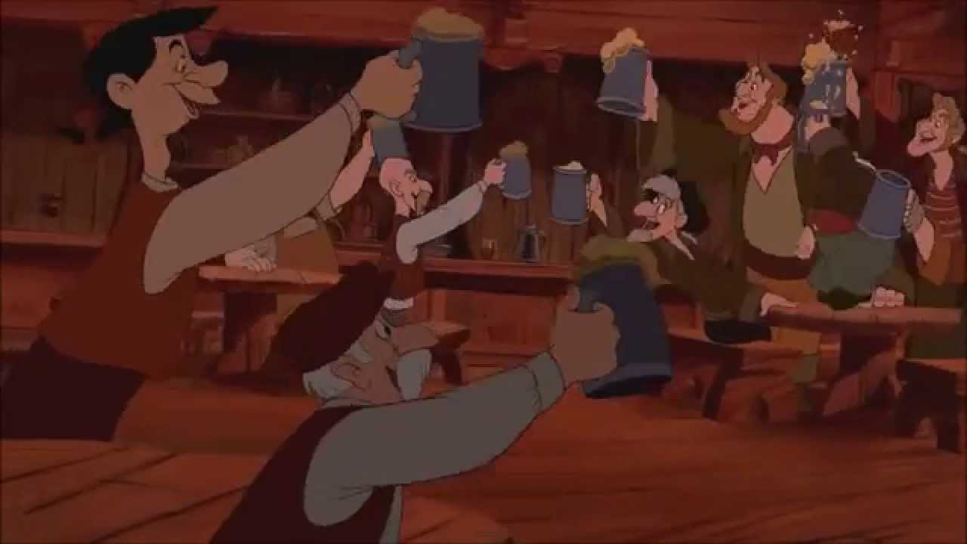
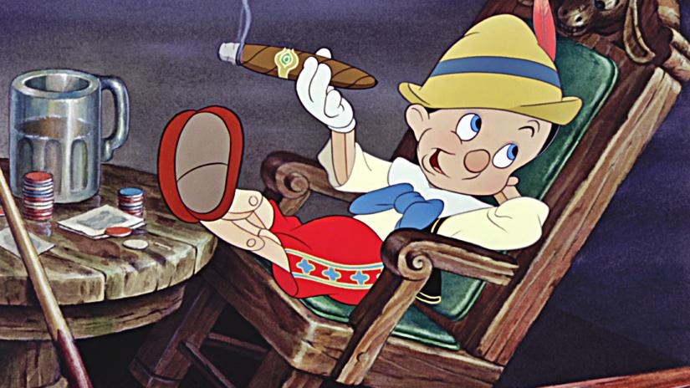
How do the images below promote substance use?
$1,600 Question from In the Media
Answer

Slide 75
Any of the following are acceptable answers. What is: fun, celebration, relaxation and romance?
$1,600 Answer from In the Media

Slide 76
During the 2019 Super Bowl, Anheuser-Busch (the makers of Budweiser, Bud Light and Michelob) spent this much on 8 commercial advertisements.
$2,000 Question from In the Media
Answer

Slide 77
What is $34 million? 15% of the 2019 Super Bowl ads focused on alcohol related products. Almost 90% of these advertisements were Anheuser-Busch brands.
$2,000 Answer from In the Media

Slide 78
This disorder occurs when a person’s use of alcohol or another substance leads to health problems at work, school and/or home.
$400 Question from Addiction
Answer

Slide 79
What is Substance Use Disorder (SUD)? SUD is also referred to as substance abuse and includes misuse, dependence and addiction and can replace terminology such as “alcoholism.”
$400 Answer from Addiction

Slide 80
This percent of the individuals arrested for a crime tested positive for illegal opioid use at the time of their arrest.
$800 Question from Addiction
Answer

Slide 81
What is 60%? Additionally, 37% were drinking when they were arrested. Substance abuse can lead to crimes and misbehaviors that can be detrimental to your wellbeing.
$800 Answer from Addiction

Slide 82
Teens who start drinking before the age of 15 are this much more likely to develop alcohol dependence or abuse in their life than those who begin drinking at age 21 or older.
$1,200 Question from Addiction
Answer

Slide 83
What is 5 times? Because our brains are not fully developed until the mid-twenties, brain function is impacted by early substance use and can be interpreted in the brain as a need for survival.
$1,200 Answer from Addiction

Slide 84
Excessive alcohol consumption contributes to more than this many deaths among youth under the age of 21 in the United States each year.
$1,600 Question from Addiction
Answer

Slide 85
What is 4,300?
$1,600 Answer from Addiction

Slide 86
True or False: If a family member is diagnosed with Substance Use Disorder (SUD), because I share the same genes with them, I will end up diagnosed with SUD.
$2,000 Question from Addiction
Answer

Slide 87
What is false? Individuals with family members who have SUD have a greater chance of developing an addiction, but this does not determine if someone will develop SUD or not.
$2,000 Answer from Addiction

Slide 88
True or False: It’s okay to use substances if my parent or guardian provides it to me.
$400 Question from Substance Use Influences
Answer

Slide 89
What is false? If a parent or guardian tries to give you illegal drugs or alcohol, you can refuse.
$400 Answer from Substance Use Influences

Slide 90
Permissive parenting, inconsistent and harsh discipline and lack of supervision are categorized as this type of risk factor.
$800 Question from Substance Use Influences
Answer

Slide 91
What is a family based risk factor?
$800 Answer from Substance Use Influences

Slide 92
This is when an individual over the age of 21 provides alcohol to someone underage.
$1,200 Question from Substance Use Influences
Answer

Slide 93
What is social providing? This individual could be a parent, older sibling, other family member or adult or even a stranger.
$1,200 Answer from Substance Use Influences

Slide 94
These are aspects of an individual, family or community that make it more likely that a person will experience a problem, such as substance misuse.
$1,600 Question from Substance Use Influences
Answer

Slide 95
What are risk factors?
$1,600 Answer from Substance Use Influences

Slide 96
To feel good, to relax, to feel grown up, to belong to a friend group and boredom are excuses youth may use to do this
$2,000 Question from Substance Use Influences
Answer

Slide 97
What is use substances?
$2,000 Answer from Substance Use Influences

Slide 98
Heart disease, lung disease, cancer, mental illness, HIV/AIDS, hepatitis and addiction or dependency caused by drug use are referred to as this type of health effect…
$400 Question from Drug Use Consequences
Answer

Slide 99
What are long-term health effects?
$400 Answer from Drug Use Consequences

Slide 100
This drug can cause the following short-term health consequences, increased heart rate and shallow breathing, dizziness and slow reaction time, red eyes and dilated pupils…
$800 Question from Drug Use Consequences
Answer

Slide 101
What is cannabis or marijuana?
$800 Answer from Drug Use Consequences

Slide 102
Drugs that cause short-term effects such as slowed breathing, slurred speech, drowsiness, poor concentration and impaired coordination are classified as….
$1,200 Question from Drug Use Consequences
Answer

Slide 103
What are depressants?
$1,200 Answer from Drug Use Consequences

Slide 104
This is a biological response to when the human body receives too much of a substance or mix of substances.
$1,600 Question from Drug Use Consequences
Answer

Slide 105
What is an overdose? In many cases overdoses are fatal, however if someone who has overdosed is treated in time they may be saved. If you believe someone has overdosed, call 911 immediately.
$1,600 Answer from Drug Use Consequences

Slide 106
Drugs that cause short-term effects such as an increase in energy and alertness, anxiety and panic attacks and an increase in heart rate and blood pressure are classified as….
$2,000 Question from Drug Use Consequences
Answer

Slide 107
What are stimulants?
$2,000 Answer from Drug Use Consequences

